Slide 1
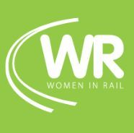

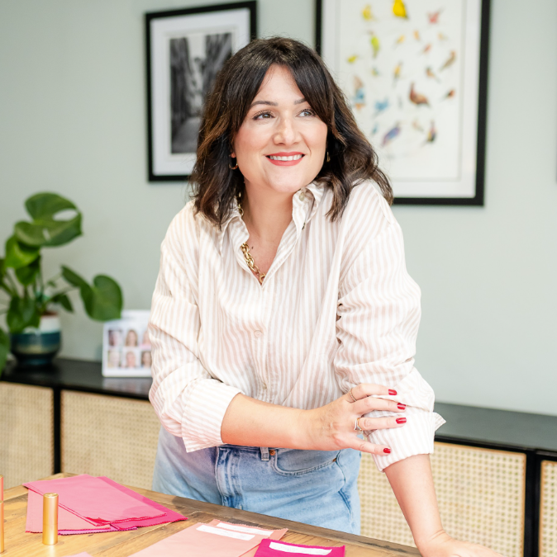


Join us on Thursday 9th October for an evening of colour, conversation and connection...
We'll be diving into the world of colour analysis and personal style to raise funds for the charities SmartWorks Greater Manchester and Women in Rail.
Event Tickets
Standard ticket - £14
Premium ticket - £28 *
* Please note, premium tickets will include a 15-minute private 1-1 session with Luisa, where you will be able to take away your own bespoke colours. We have 8 spots available and anticipate a high demand for this service – please book early to avoid disappointment.
We look forward to seeing you there,
Women in Rail North West
North West
Click here to secure your place.
What will the evening will cover?
5:30pm – Arrivals & drinks reception
6:00pm – An introduction to Smart Works and Women in Rail
6.15-7.00pm – Speaker Session with Luisa Giannini
  Luisa will cover seasonal colour analysis, what to look for, colour advice and time for Q&A.
7-9pm – Networking and drinks
9pm – Close
This event is kindly sponsored and hosted by Mott McDonald

